Slide 2
Acknowledgement of Country
AIDR acknowledges the Traditional Custodians of the various lands on which you all join us from today and the Aboriginal and Torres Strait Islander people participating in this event.
We pay our respects to Elders past and present and celebrate the diversity of Aboriginal peoples and their ongoing cultures and connections to the lands and waters across Australia.

Slide 3
Housekeeping
You will remain muted and your camera will not be activated for the duration of today’s event.
Today’s event will be recorded and made available after the event.
Please enter questions for our speakers in the Q&A function, not the chat box.
Please use the chat box to share any thoughts or reflections during the presentation
Please be respectful to each other when posting your comments or questions.

Slide 4
Welcome
John Richardson
Executive Director
Australian Institute for Disaster Resilience (AIDR)

Slide 5
Speaker Introduction
Dr Bhiamie Williamson
Associate Professor
Program Lead, National Indigenous Disaster Resilience
Associate Dean Indigenous, Monash University

Slide 6
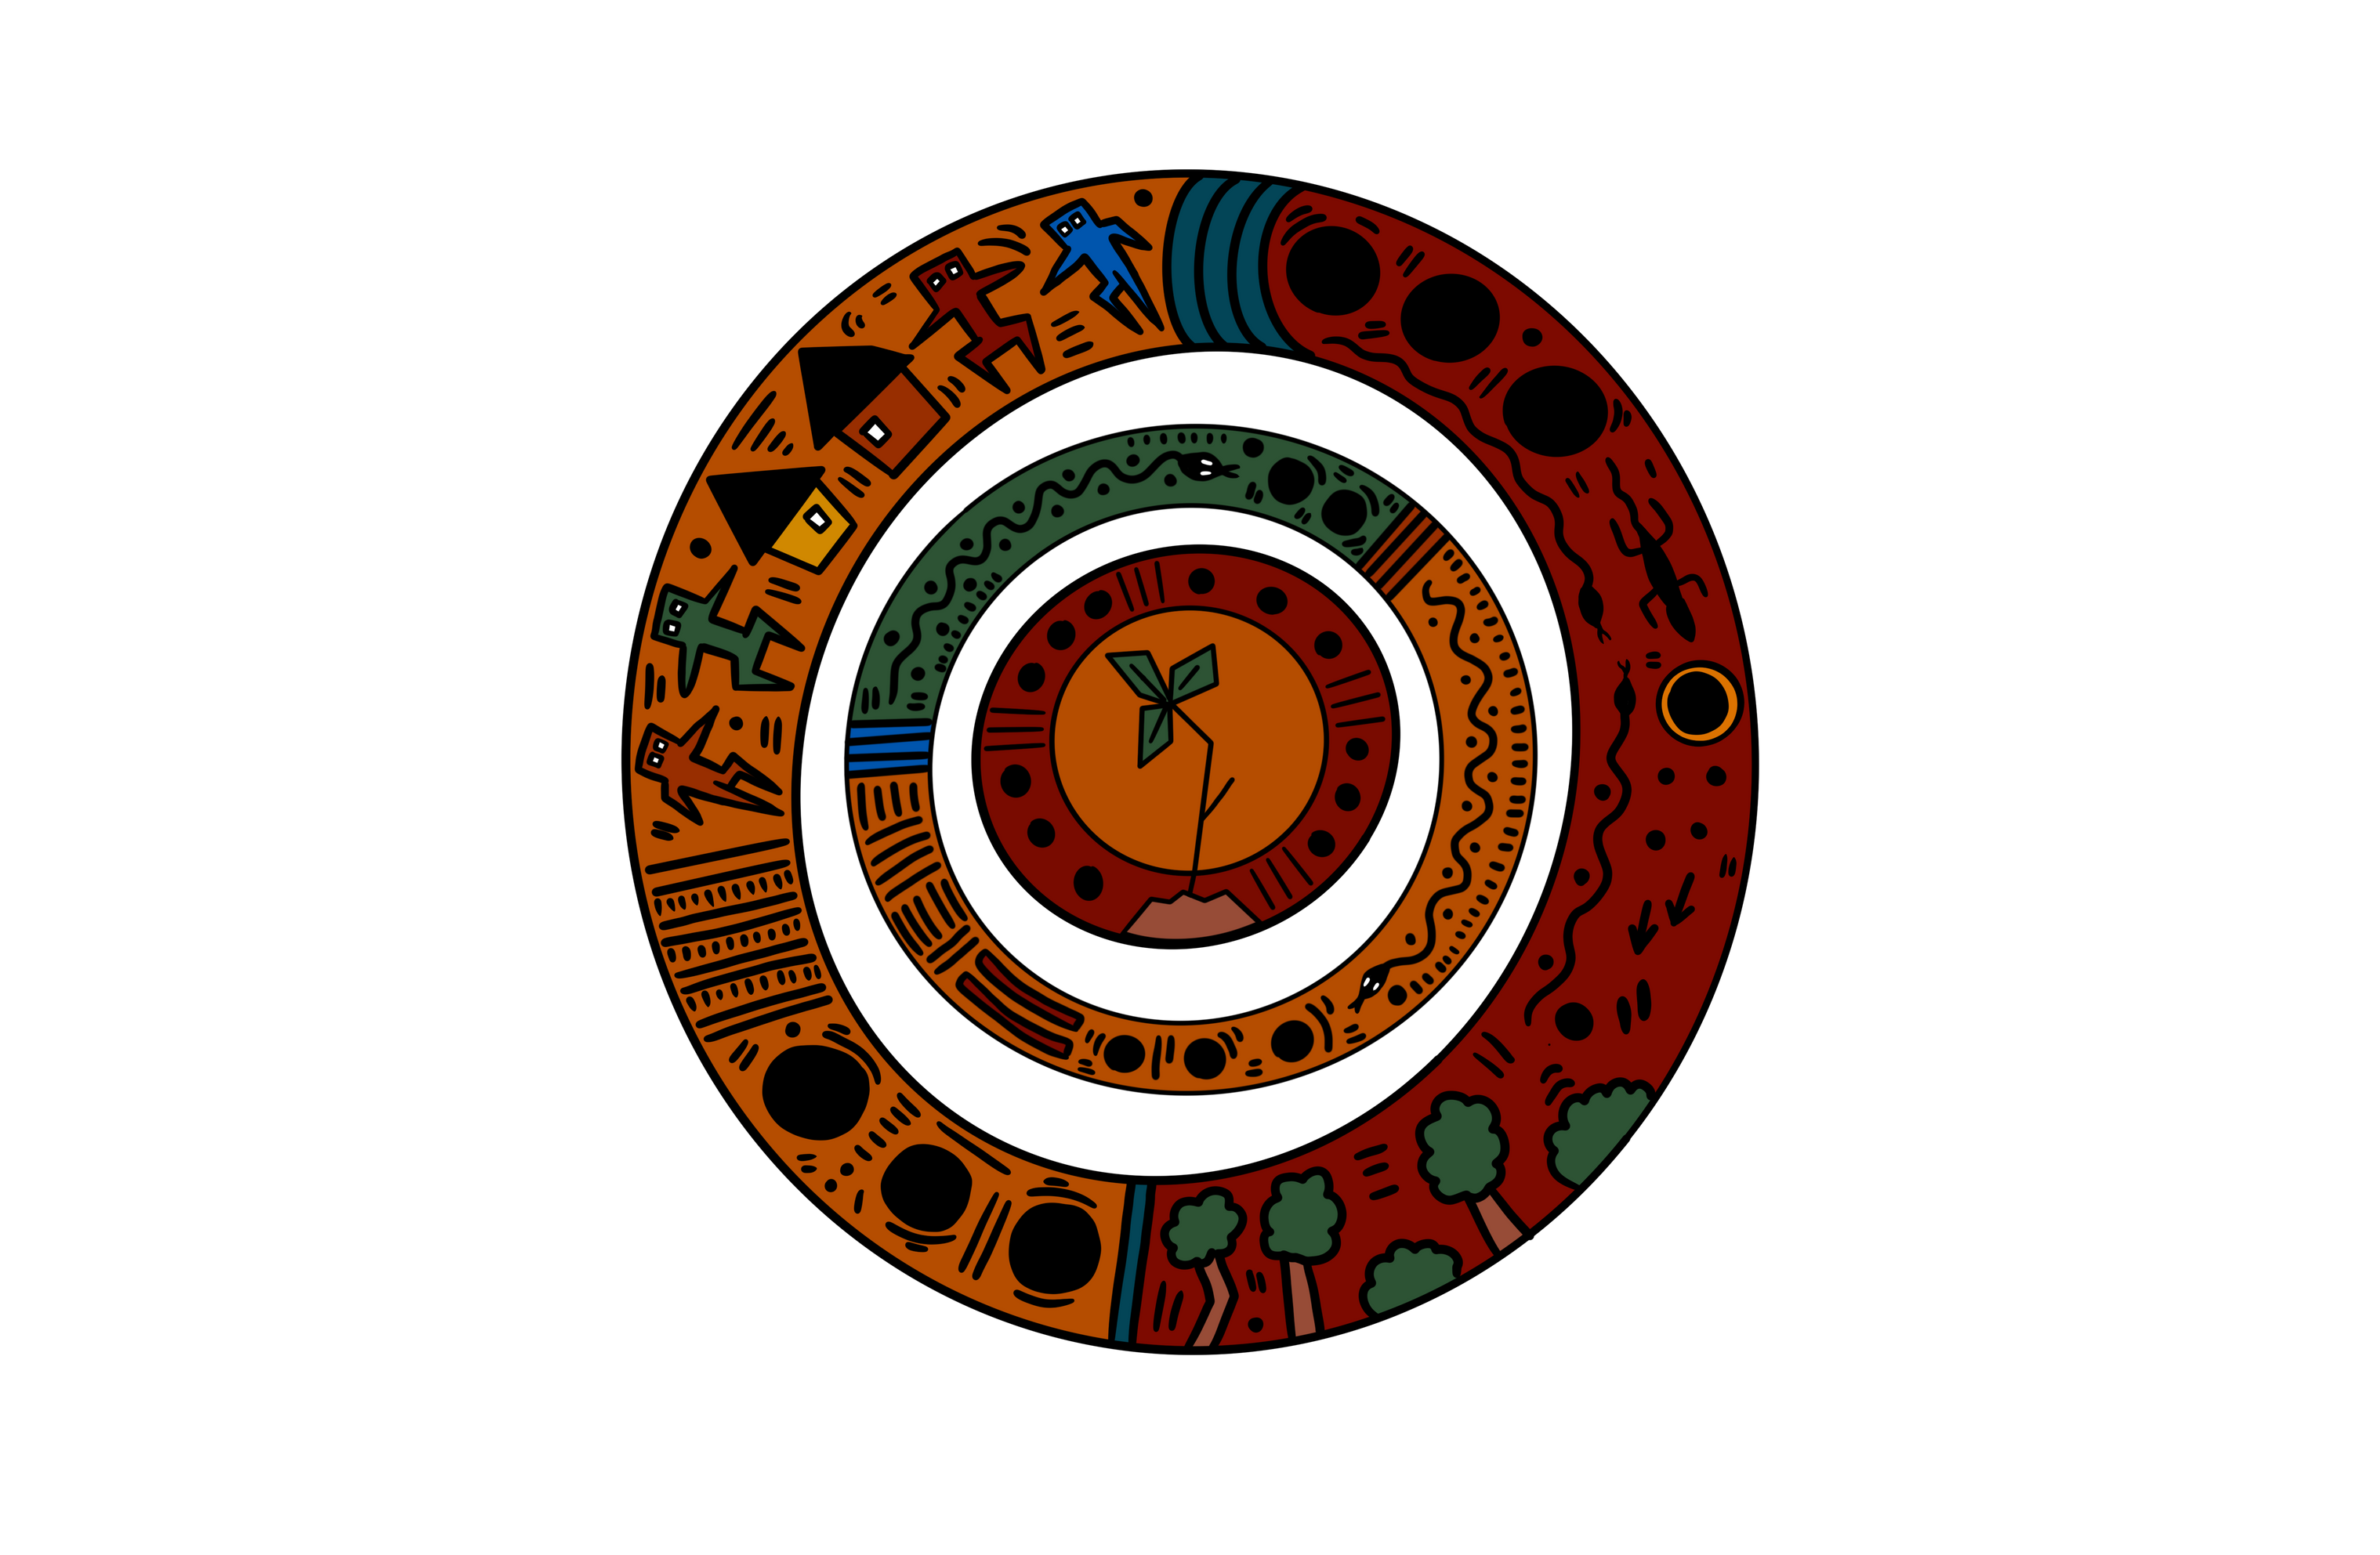
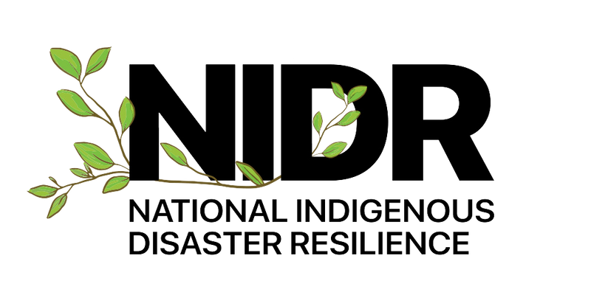
What we miss when we say ‘disproportionate’: A 4-pillar lens on Indigenous disaster resilience
Associate Professor Bhiamie Williamson
Thursday 18 September 2025

Slide 7
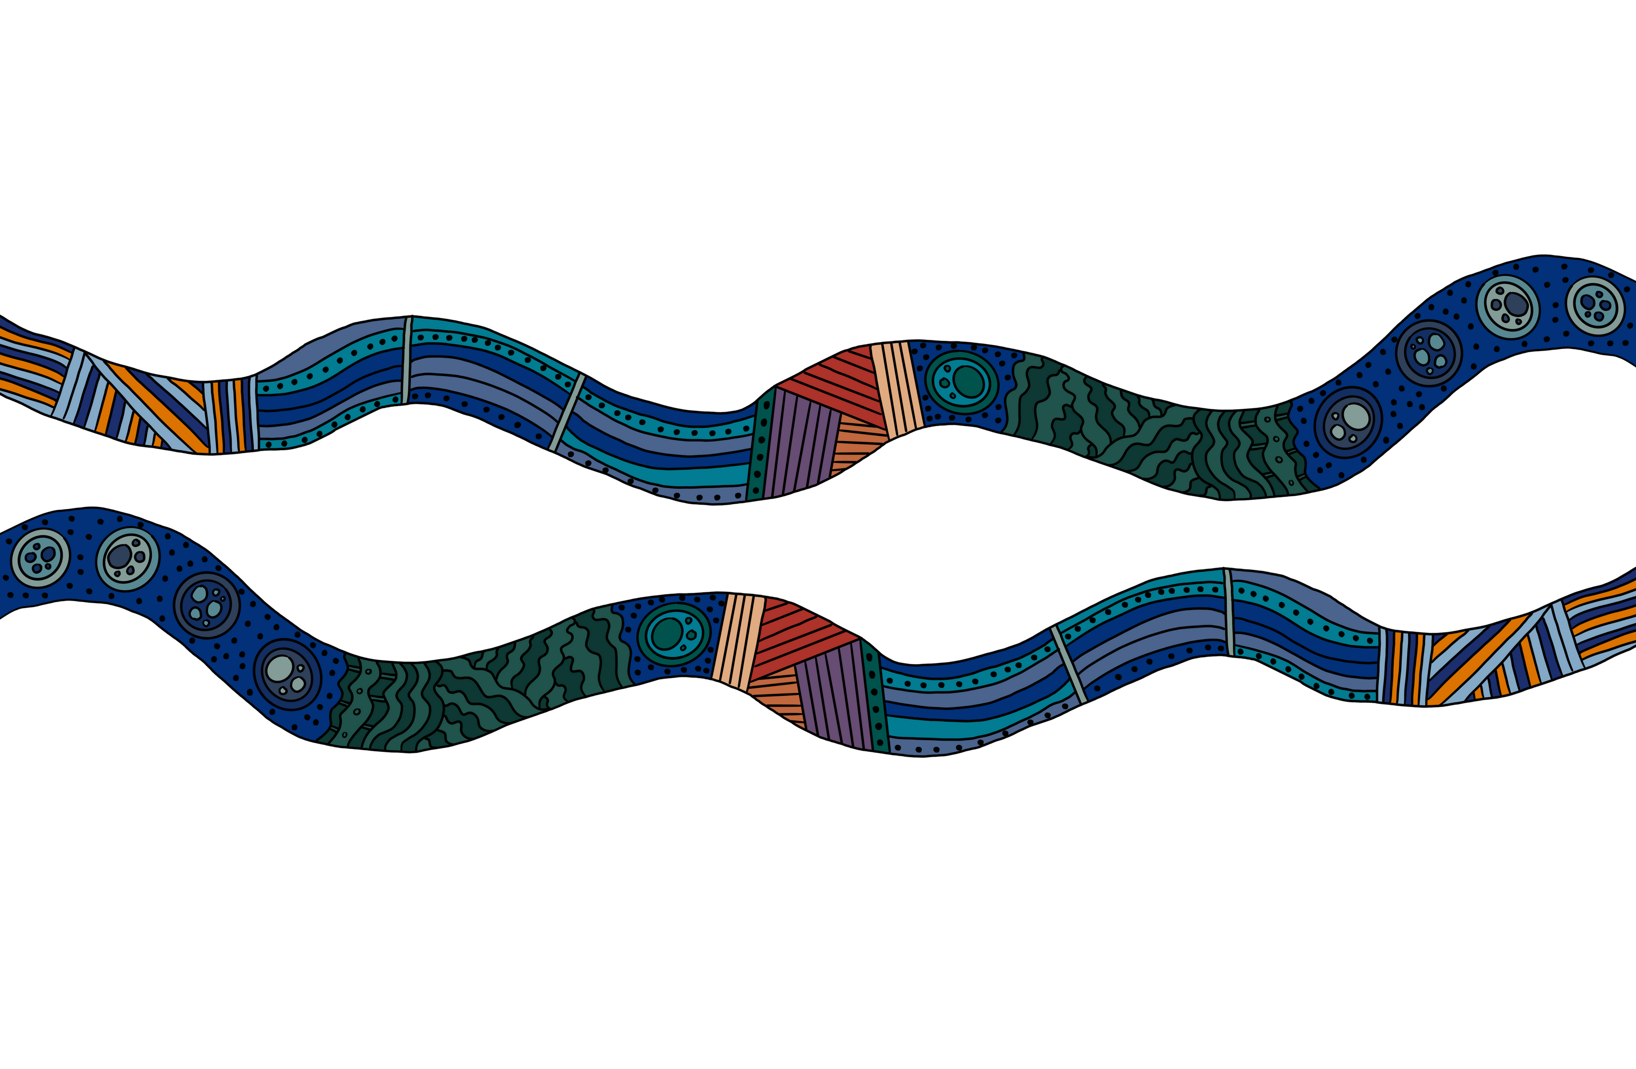
ACKNOWLEDGEMENT OF COUNTRY
We acknowledge the Traditional Owners of Country across Australia.
We pay our respect to them, their culture, and Elders past and present.

Slide 8
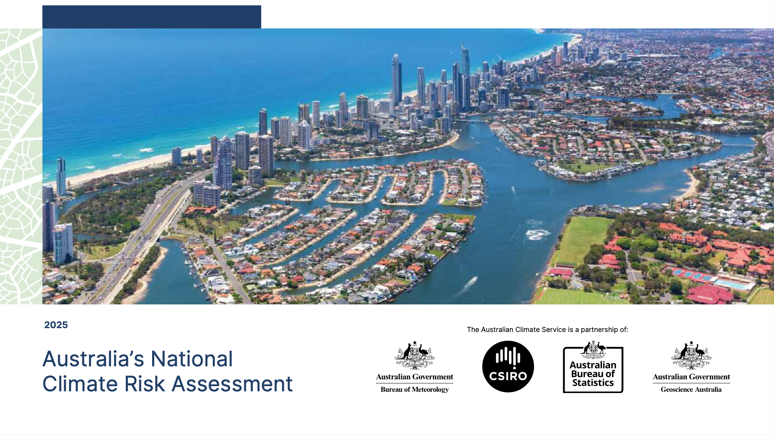

Slide 9
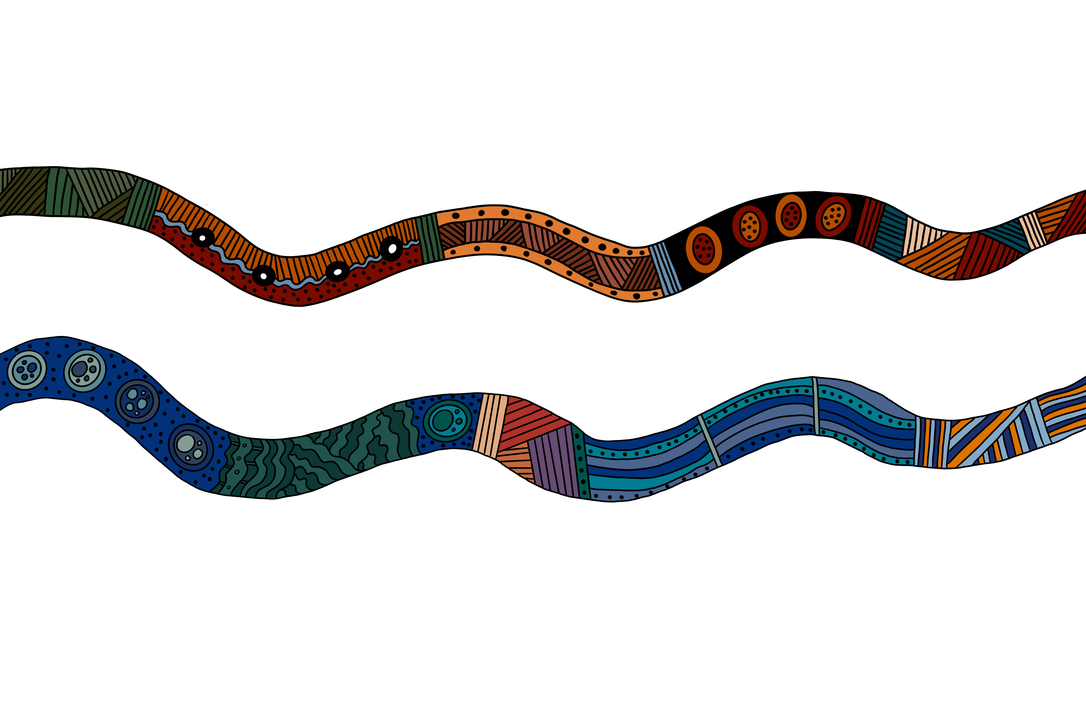
Climate Risk Assessment Report
Extreme weather events (heatwaves, floods, bushfires, cyclones, storms) will be more frequent and severe.
Annual costs of climate disasters could reach ~$40 billion by 2050 (even under modest warming).
Rising sea levels is already threating low-lying island communities, with flooding and tidal intrusions putting millions of people living along the coast at risk.
Many homes could become uninsurable in high-risk regions.

Slide 10
Climate Risk Assessment Report
Health systems will be stretched, with cascading health impacts such as disease and infection more common
Emergency services will become more overwhelmed, more often.
Critical infrastructure such as energy, water, transport, and communications are vulnerable to damage and disruption.
Financial impacts will become more pronounced including rising insurance premiums, disrupted food systems and supply chains.

Slide 11
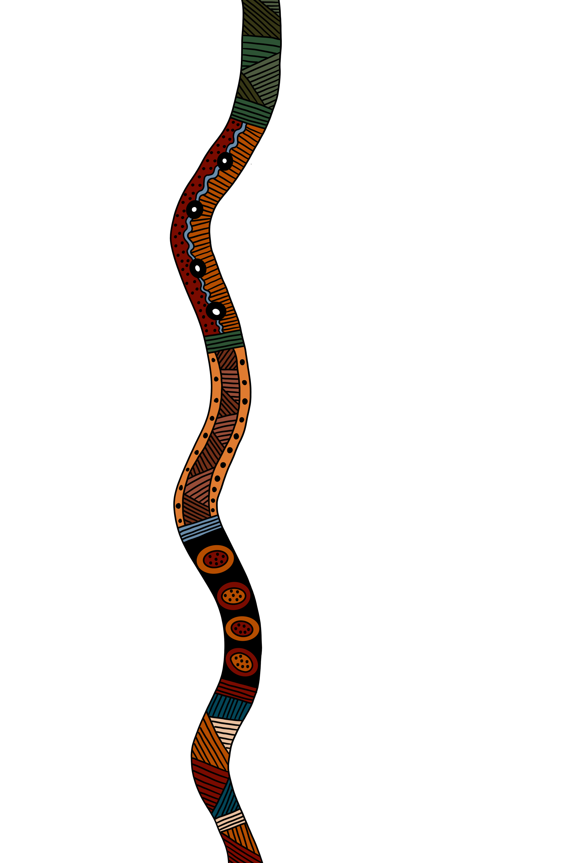
Climate Risk Assessment Report
Multiple disasters hitting together will strain all levels of society.
Institutions will experience systemic stress with health, emergency, infrastructure, and social support systems pushed beyond capacity.
Urgent need for resilience planning, adaptation, and coordinated response to reduce escalating impacts.
No community is invulnerable — risks are nationwide.
Within this context of increased vulnerability for all, the ability to respond, adapt, and enjoy a greater sense of security and safety are more fully enjoyed by some.

Slide 12

It is well established that throughout the world, some nations have less ability to respond to the increasing impacts of climate change. These nations are generally known as the ‘global south’, a collection of nations that (generally) have fewer financial resources, administrative maturity, and infrastructure to cope with and respond to shocks from environmental disasters such as wildfires, floods, storms, heatwaves and rising oceans.
Global climate finance was established under the United Nations climate agreements to provide financial support from wealthier, high-emitting nations to developing countries, recognising their limited resources and disproportionate vulnerability to climate change driven natural disasters.

Slide 13
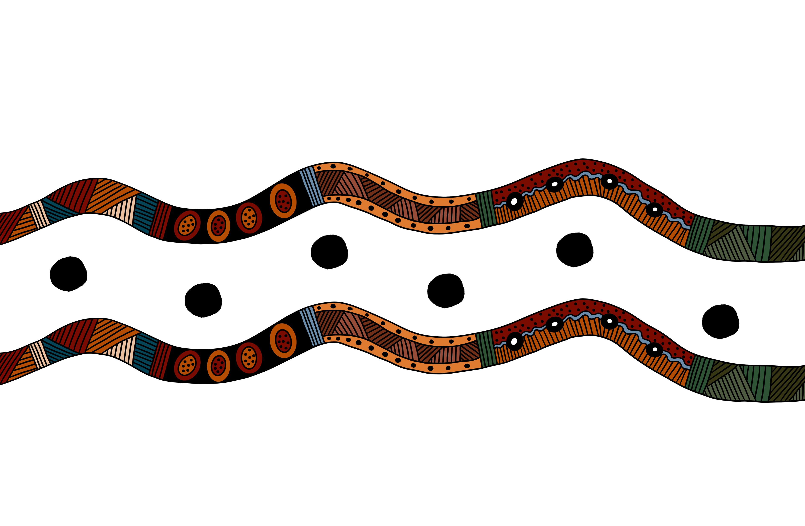
Just as it is widely recognised that inequality exists between nations, inequality also exists within nations.

Slide 14
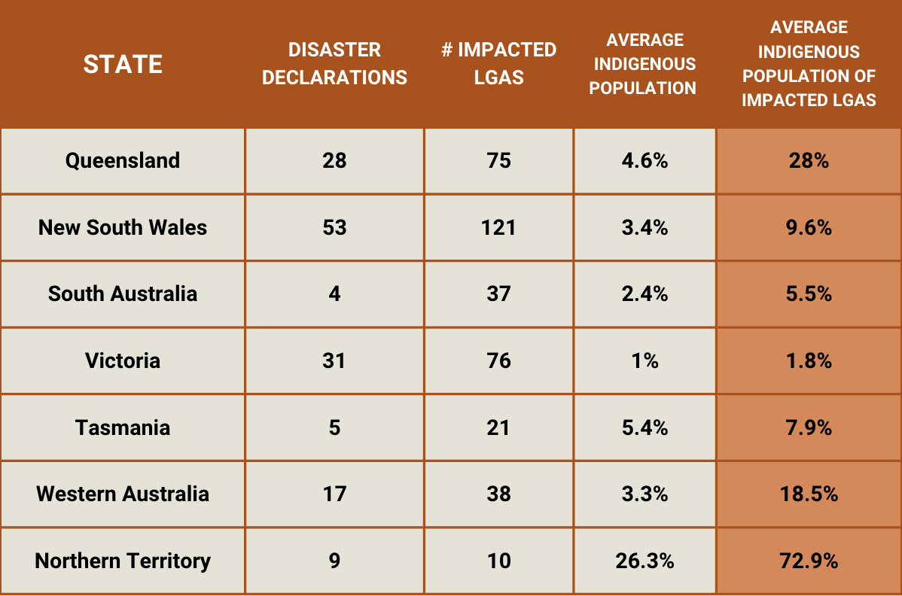
What do we mean by ‘disproportionate’?

Slide 15
What do we mean by ‘disproportionate’?
‘Disproportionate’ is used to describe the increased exposure of Indigenous populations to disaster events.
Whether by LGA, state or territory, over different time scales and hazard events, Indigenous peoples represent a higher proportion of the population in areas where disasters unfold.
The language of ‘disproportionate impacts’ allows us to describe a problem, but it doesn’t provide a framework for action to address it.

Slide 16
Legacies of colonisation
The legacies of colonisation continue to reverberate throughout modern Indigenous communities.
As well as the more commonly known aspects of colonisation such as introduced disease, massacres, displacement from land and removal of children, there were other political and economic disadvantages that had lasting impacts.

Slide 17
Legacies of colonisation
Most (in some places, all) Indigenous peoples were not allowed to work, or those who were such as in the pastoral industries throughout northern Australia, were not paid for their work.
Indigenous peoples were largely disenfranchised, being unable to vote or stand for representative positions in Australia’s parliaments.
With the exception of returned soldiers, Indigenous people were not permitted to own their own homes. Yet even if a soldier brought a house for their family, they could not transmit that to their descendants.
The impacts of these economic and political disadvantages continue to have consequences for Indigenous peoples today.

Slide 18
Historical legacies, contemporary vulnerabilities
Contemporary vulnerabilities in Indigenous communities such as lack of employment, political disempowerment, lower educational attainment, and lower rates of home ownership, have their origin in historical legacies of colonisation and introduced systems of disadvantages forced on Indigenous communities and sustained through intergenerational inequality.

Slide 19
Without an appreciation of where these vulnerabilities come from, we will be ill-equipped and unprepared to support modern resilience building of contemporary Indigenous communities.

Slide 20
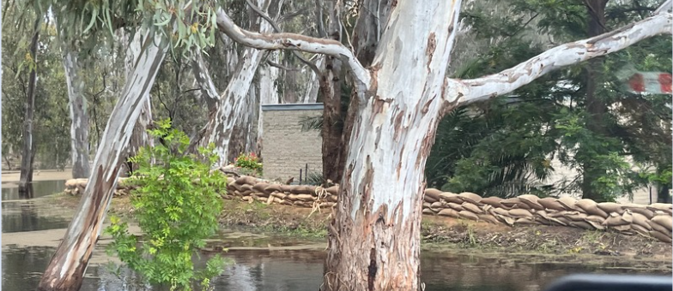
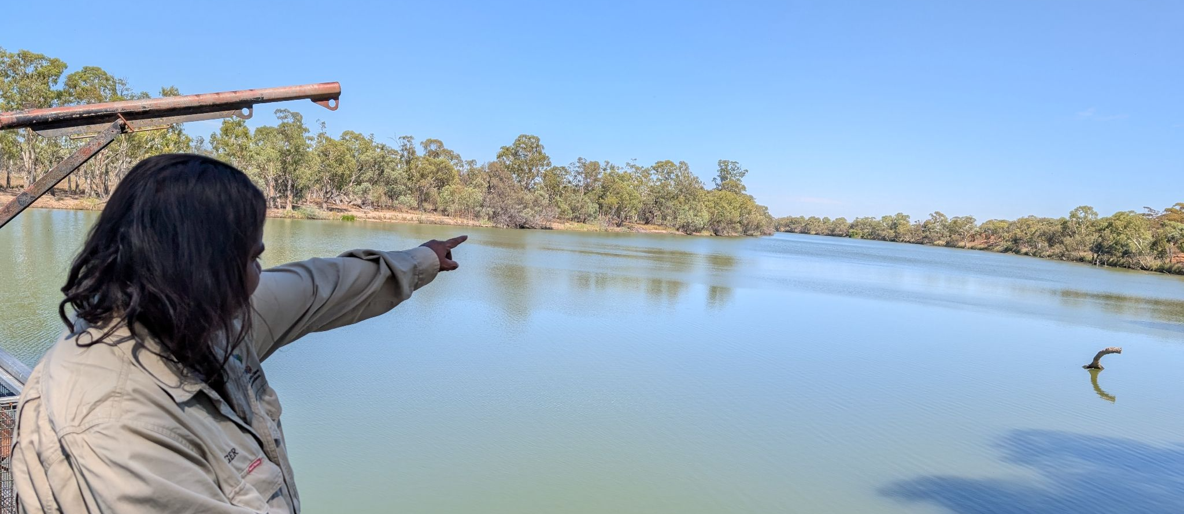
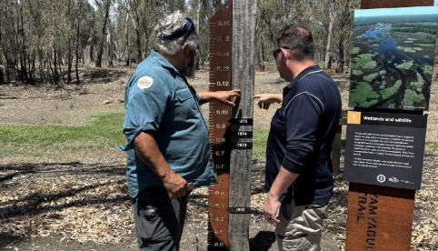

Slide 21
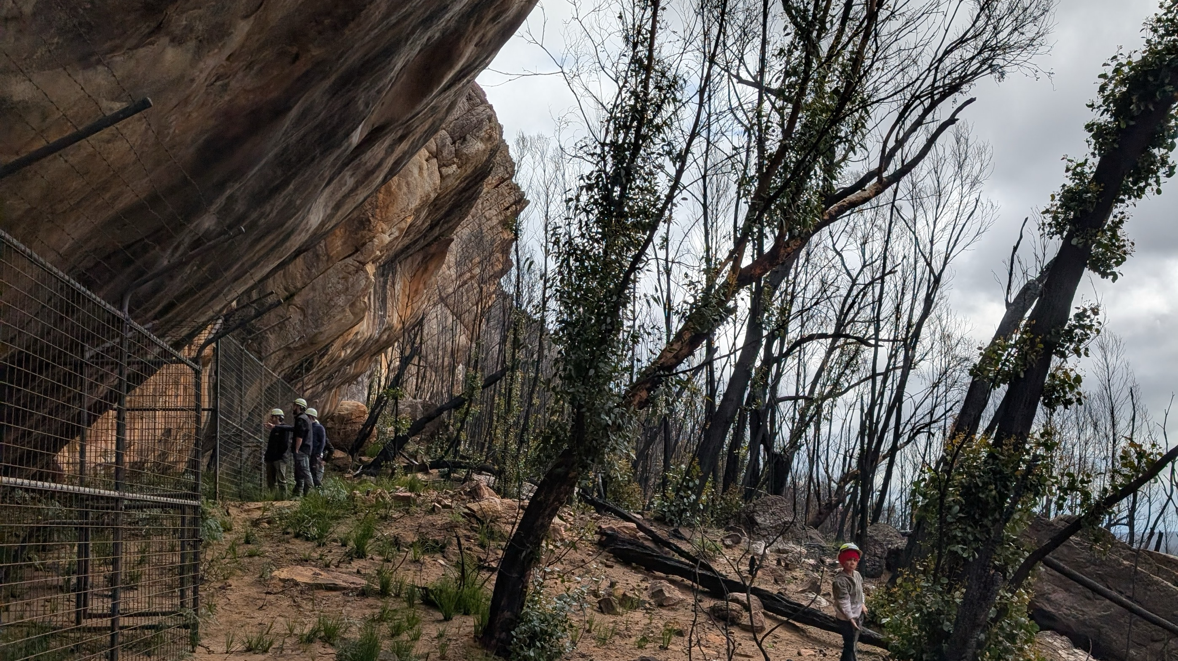
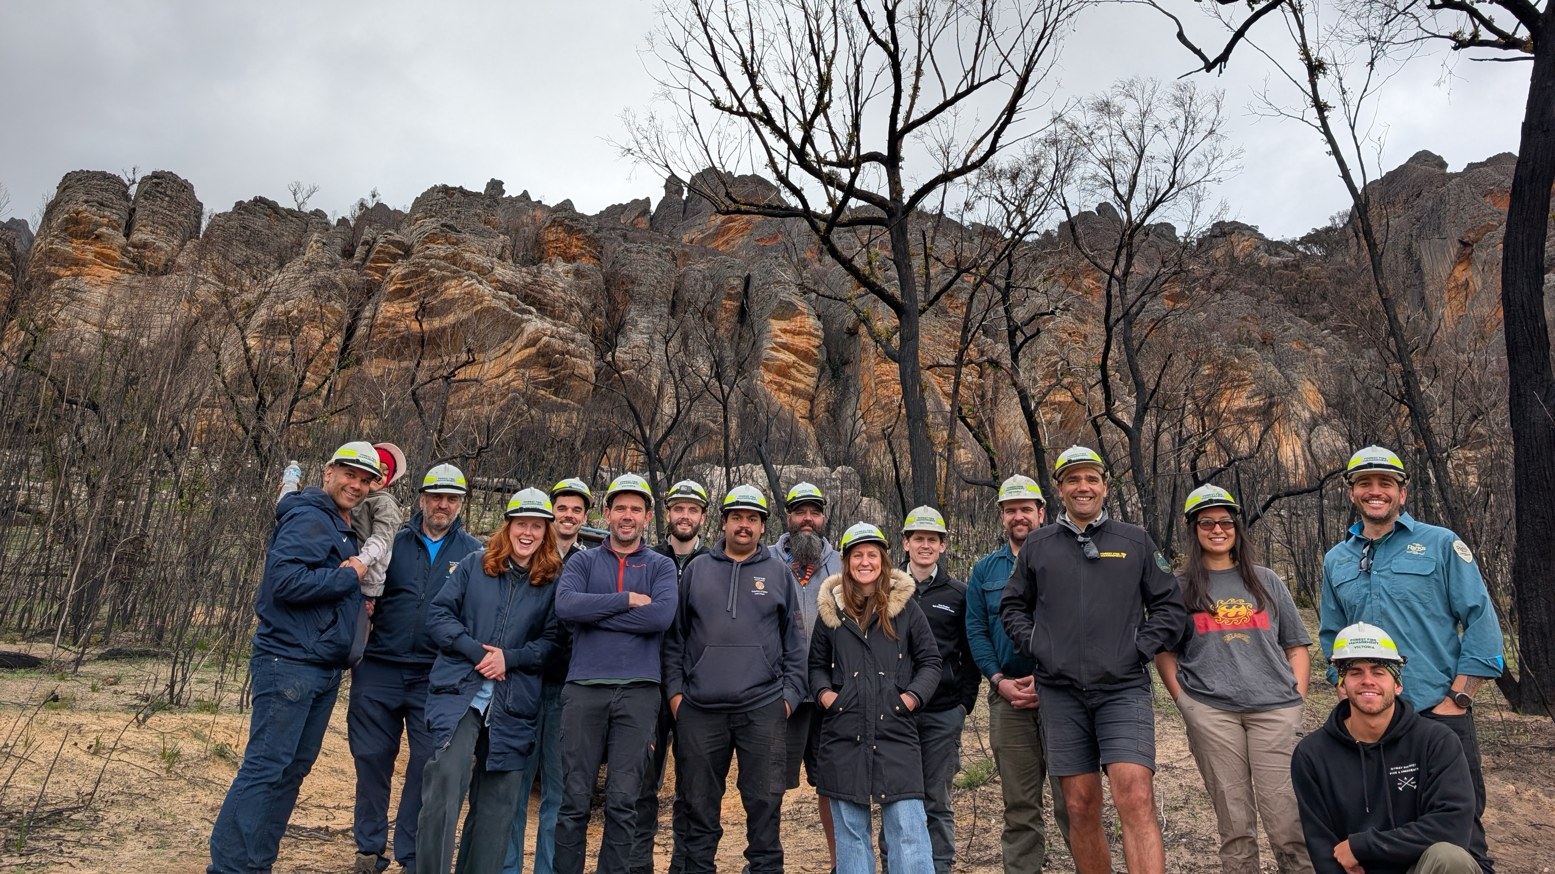
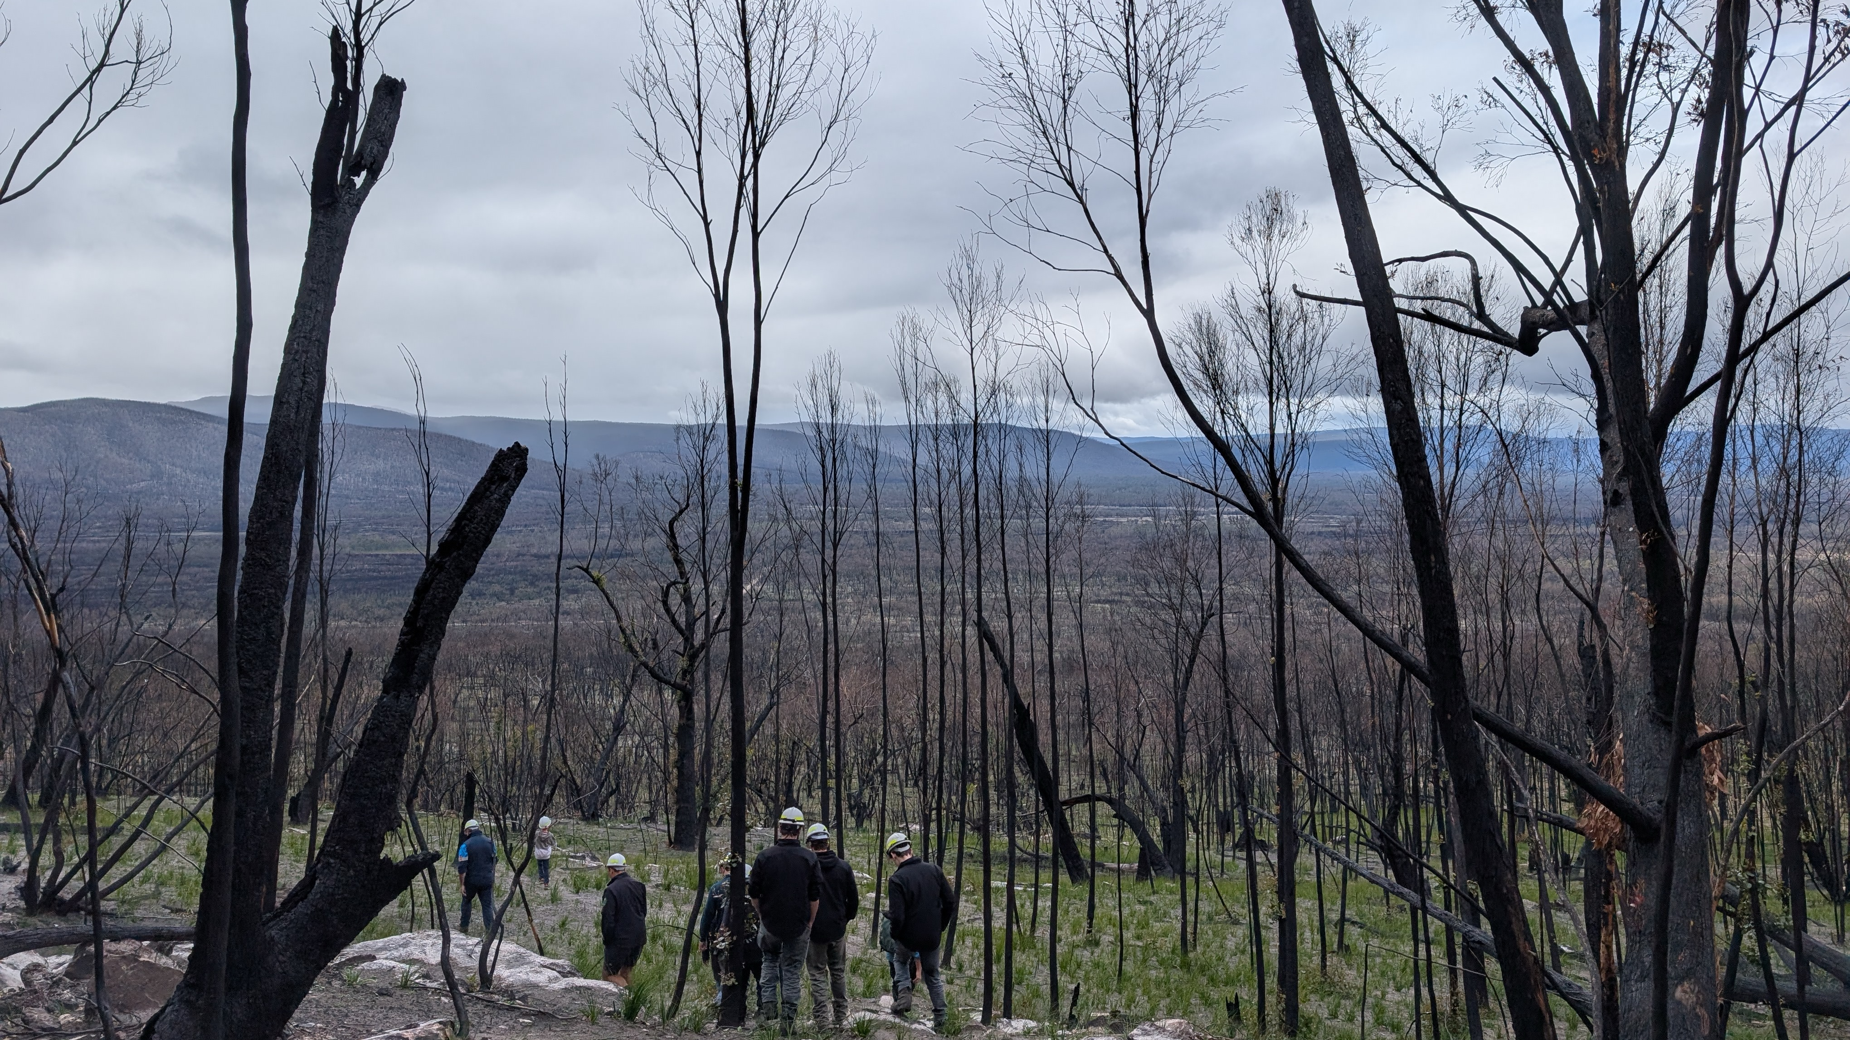
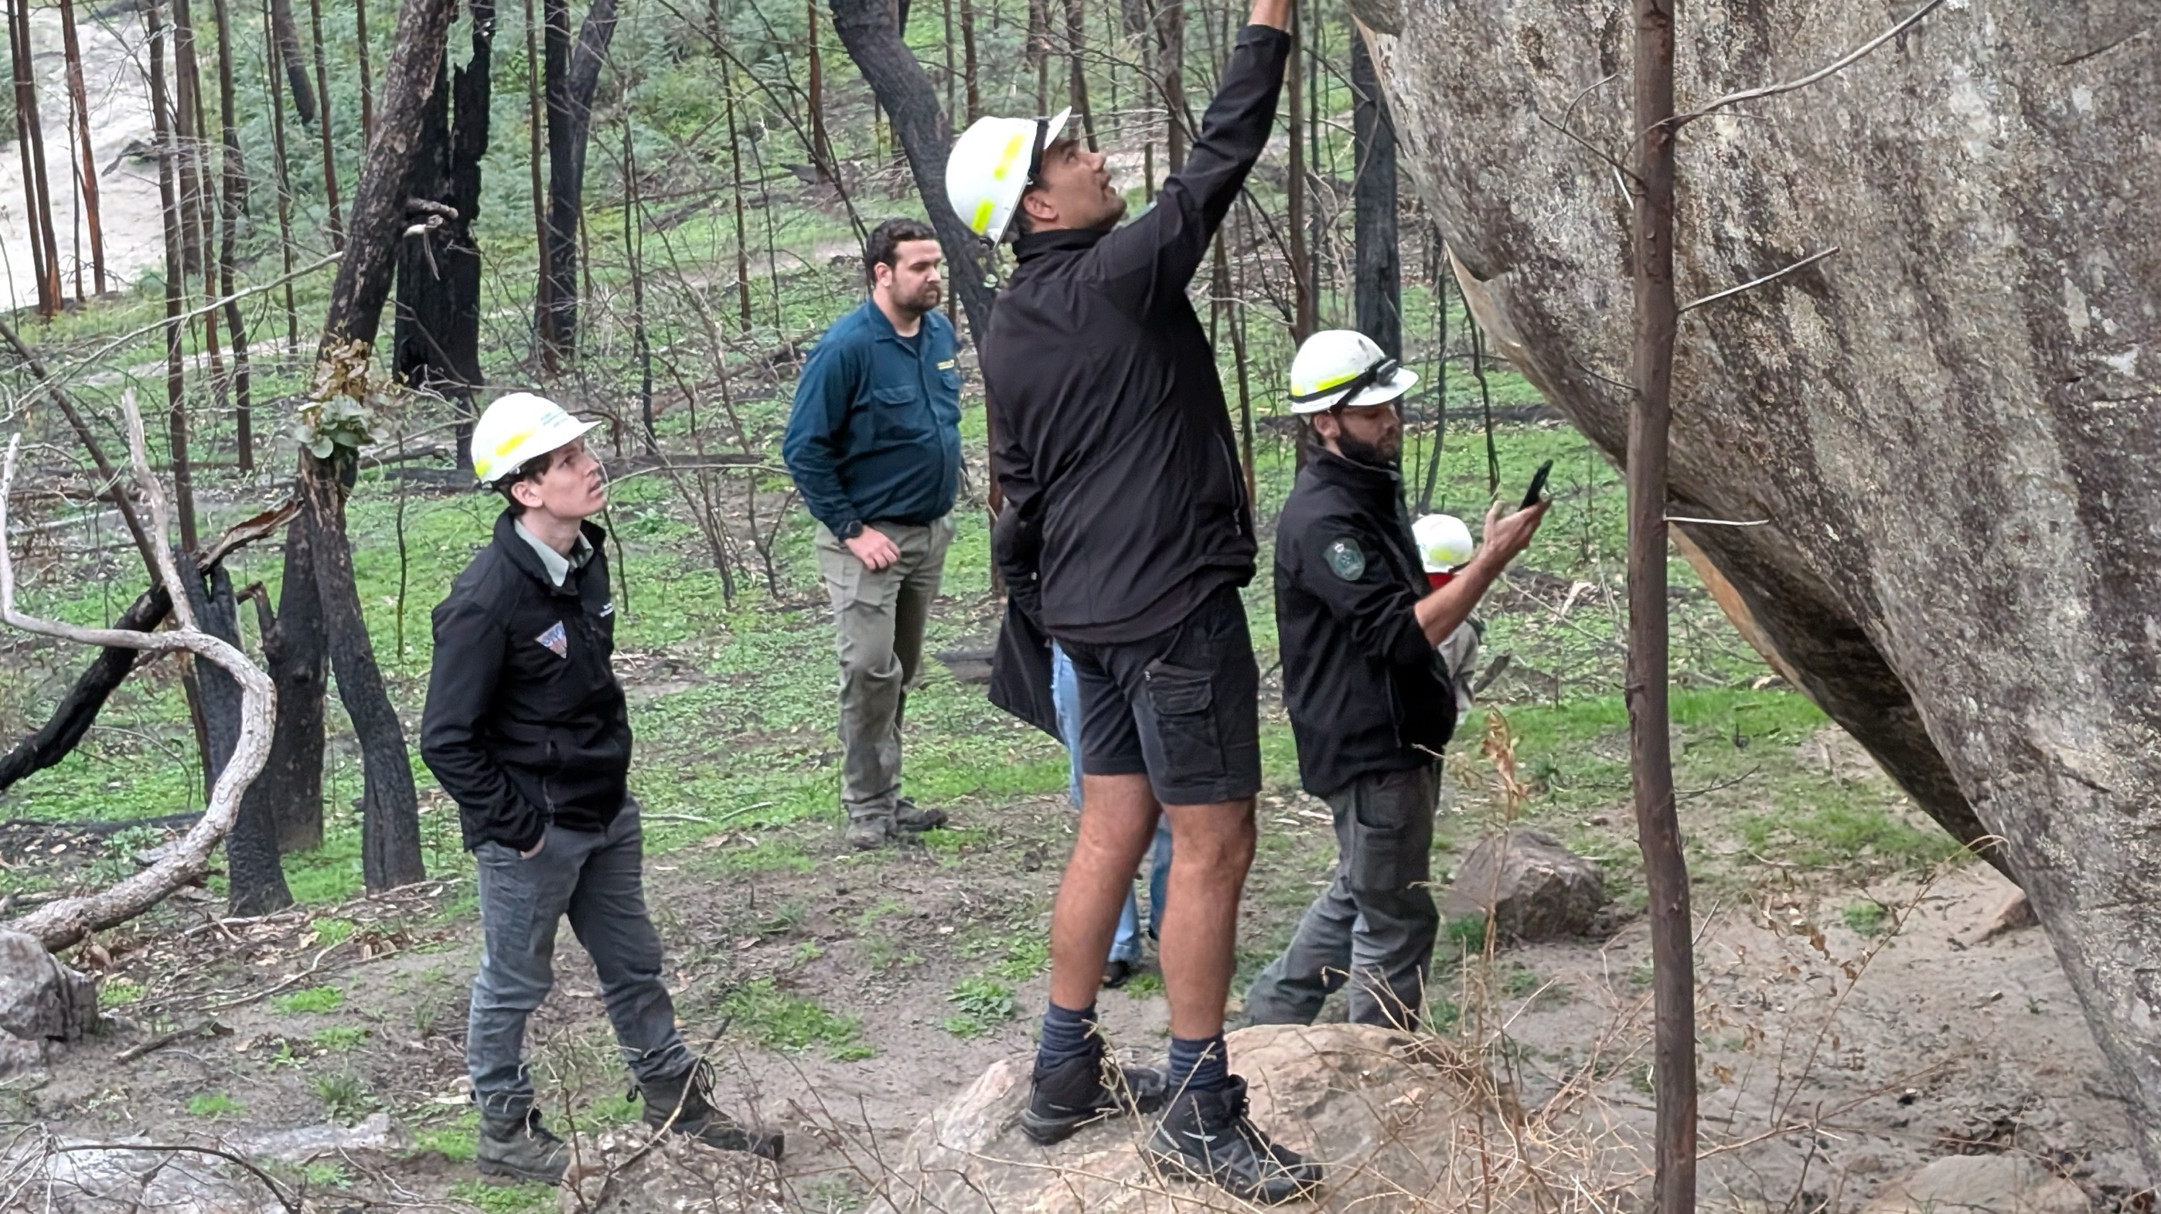

Slide 22
Political
Social
Economic
Spiritual

Slide 23
Political
Restoration of pre-colonial political communities
Sensitive to the forced political disempowerment of Indigenous groups
Respecting the internal politics within communities, and between Indigenous groups and the wider regions they live within
Laws change in response to prevailing political times
Observing the political imperative for governments to be seen as supporting the resilience building of all communities, including Indigenous communities
Indigenous community and representative organisations exercising the sizeable political capital they now hold

Slide 24
Economic
Re-establishing land-based economies
Understanding that Indigenous peoples have been made poor because of discriminatory laws and policies from successive governments
Seeking out opportunities in the large-scale investment of community resilience
Utilising periods of repair, recovery and reconstruction to address historical economic disempowerment
Investing in the community controlled sector and building adaptable and resilience workforces for the future

Slide 25
Social
Respecting the sanctity of Indigenous communities and kin networks
Having regard for the importance of Caring for Country to promote social harmony
Understanding the social disintegration of modern communities because of the depravities of colonisation
Responding with respect to social challenges, while building on the strengths of modern Indigenous communities
Reinforcing social systems, not applying additional pressure through policies, laws and financial grant opportunities

Slide 26
Spiritual
Understanding the unique spiritual context of Indigenous communities, and the sanctity of connection with Country
Knowing that assaults on Indigenous communities were assaults on the spiritual basis of life for groups
Desecration to the land, including from major disaster events, contributes to the spiritual degradation of Indigenous groups
Just as degradation contributes to the spiritual degradation of groups, so does land restitution and Caring for Country repair spiritual wellbeing
Recognising that Indigenous groups have an inherent spiritual resilience, which needs to be accounted for in resilience planning and recovery efforts

Slide 27
Political
Social
Economic
Spiritual

Slide 28
Cultural determinants of Indigenous resilience
These four dimensions might be understood as cultural determinants of Indigenous resilience. They represent an intellectual framework to understand what might be done to enhance resilience, and distinct sites of recovery.

Slide 29
Cultural determinants of Indigenous resilience
Placing resilience and recovery within a broader historical timeline allows us to more accurately describes the status of Indigenous vulnerability, as emerging from the legacies of colonisation. Doing this builds power and agency within the sector as a distinct site where through our work, we can address historical injustices and take practical steps build resilience. Resilience practitioners then become agents of change.

Slide 30
Australian Climate Risk Assessment Report – we’re in trouble
Inequity within nations
Place Indigenous vulnerabilities within the context of colonisation
Introduced four pillars of Indigenous resilience
Political
Economic
Social
Spiritual
Cultural determinants of Indigenous resilience
Appreciating that resilience and recovery are unique sites where it is possible to both enhance resilience and address historical injustice

Slide 31

To stay up to date with NIDR research and events
Follow us on LinkedIn
E: nidr@monash.edu

Slide 32
Q&A
Don’t forget to put your questions in the Q&A function.

Slide 33
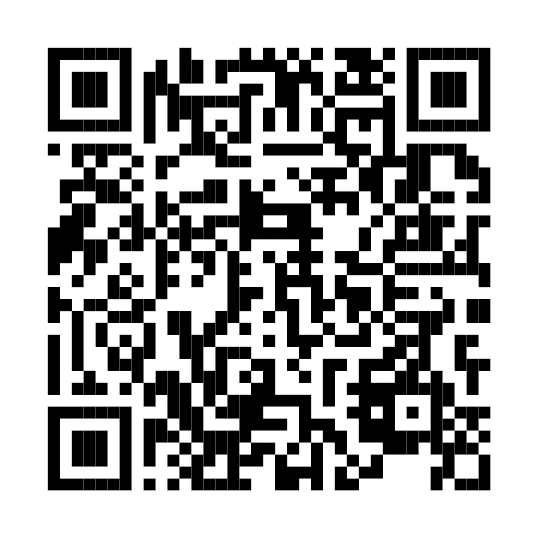
Event concludes
Thank you for attending today’s webinar.
Next webinar:
2024-25 Major Incidents Report Showcase
Wednesday 1 October 2025, 1.00pm-2.30pm AEST
Register now.

